Slide 1
● PUNJAB AGRO INDUSTRIES CORPORATION (PAIC) - MEGA FOOD PARK ● PUNJAB AGRO JUICES LIMITED (PAJL) - PROCESSING OF FRUITS & VEGETABLES. ● PUNJAB AGRI EXPORT CORPORATION (PAGREXCO) - FRESH FRUITS & VEGETABLES - CERTIFIED ORGANIC FOODGRAINS - PACK HOUSES & COLD CHAIN INFRASTRUCTURE
PUNJAB AGRO

Slide 2
MEGA FOOD PARK, LADHOWAL, LUDHIANA
PAIC is setting up this Food Park with an investment of Rs.117.61 Cr. (MoFPI-Rs.50 Cr.; NABARD – Rs.27 Cr.; PAIC – Rs.41 Cr.)
Based on Hub & Spoke Model: Hub at Ladhowal & Spokes at Abohar, Hoshiarpur, Amritsar and Bathinda
At Ladhowal, units are provided with state-of-art enabling basic infrastructure and core common processing facilities.
Entrepreneurs are required to focus on establishment/running of their respective processing units.
Standard factory buildings with plug & play facilities have also been set up for MSME units.
Spokes are being provided with cold stores, warehouses, etc.
Developed plots ranging from 1500 sq. yd to 6000 sq. yd are available @4,400/- per sq. yard

Slide 3
BIRD EYE VIEW - CPC

Slide 4
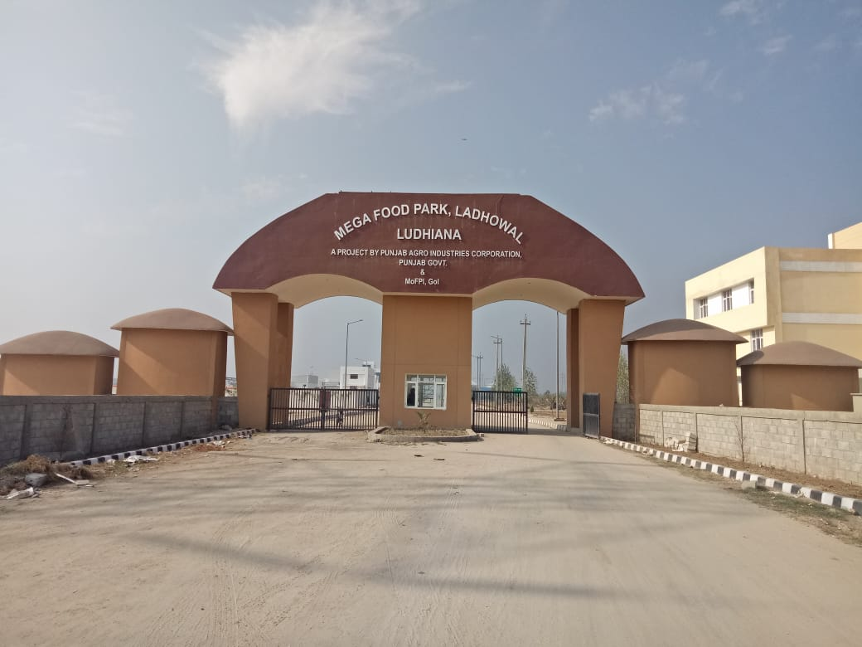
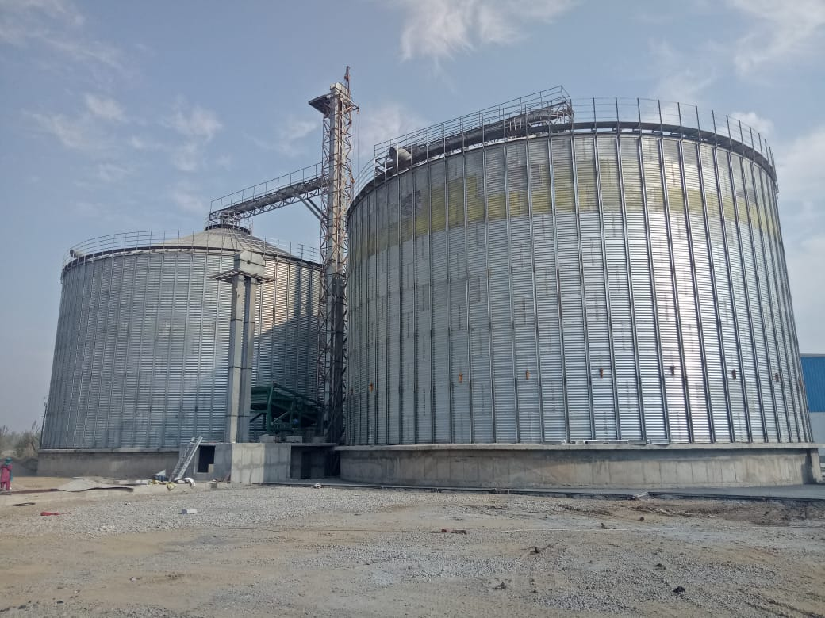
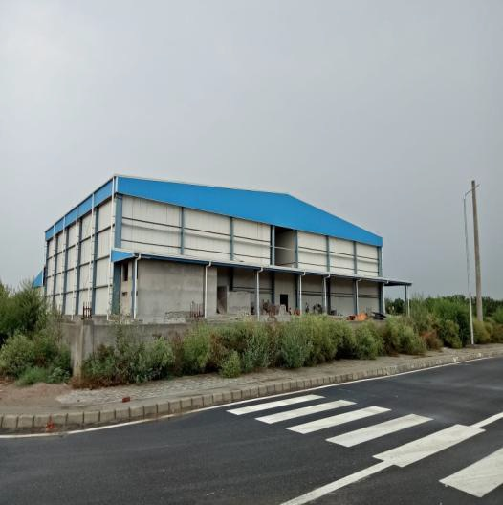
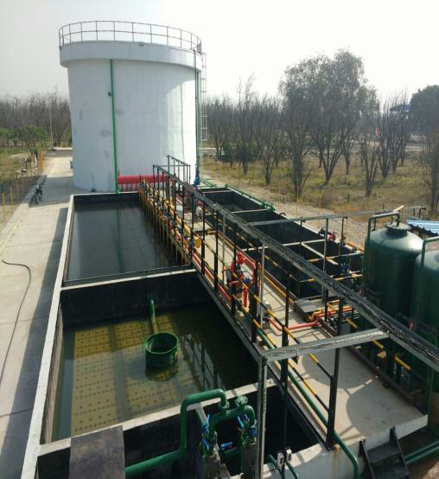
ACTUAL SITE PHOTOGRAPHS

Slide 5
A SPECIAL PURPOSE VEHICLE
PUNJAB AGRO JUICES LIMITED
Established in 2006 by Government of Punjab (India).
● To support the small & marginal farmers.
- Provide remunerative price to the farmers of their produce.
- Employment to the local people.
● To process state’s horticulture produce having short harvesting seasons.
- State of the art infrastructure.
- Reduction in wastage of unsold produce.
- Processing of wide range of fruits & vegetables.

Slide 6
PUNJAB AGRO JUICES LIMITED
Two multi fruit and vegetable processing plants.
Suitable for processing of all tropical fruits & vegetables.
Quick changeover for processing of different fruits & vegetables.
Processing capacity of each plant:-
- upto 20 MT per hour for citrus fruit.
- upto 10 MT per hour for other fruits & vegetables.
- Cold Storage capacity @ 1000 MT.
- Deep Freezer capacity @ 1000 MT.
- De-bittering facility for citrus fruits.
INFRASTRUCTURE

Slide 7
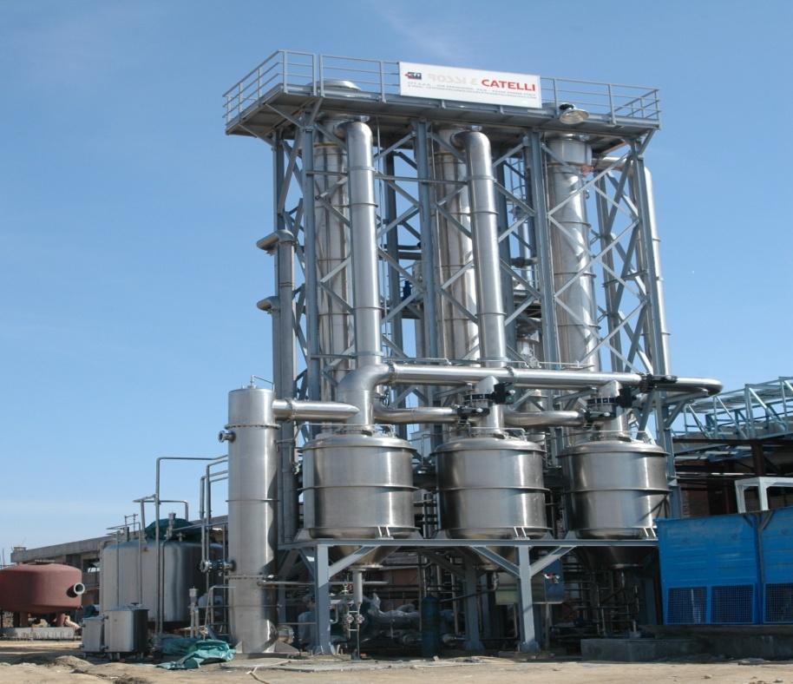
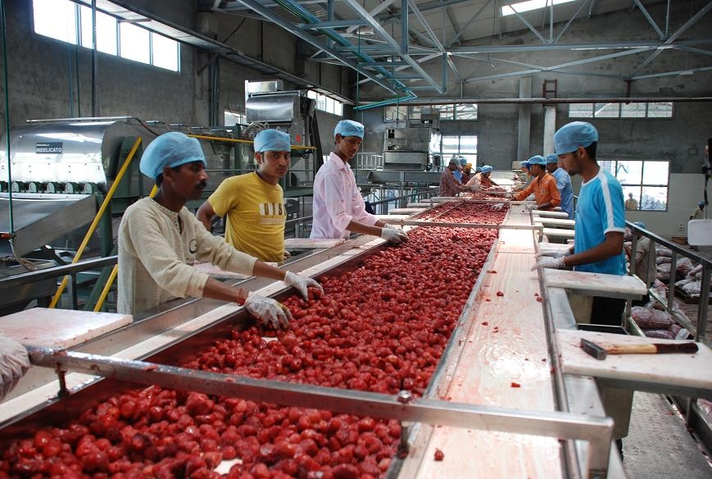
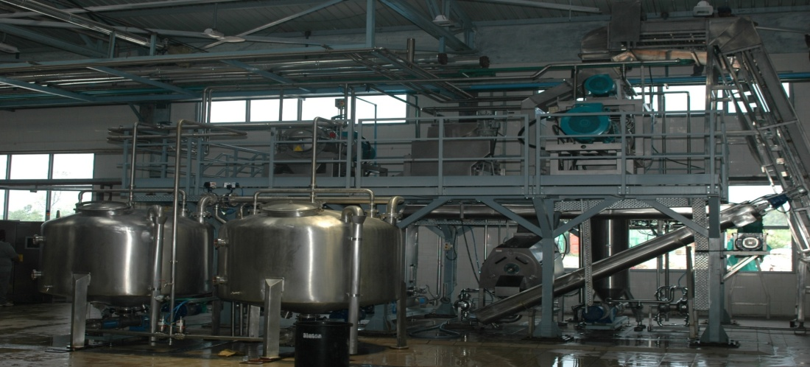
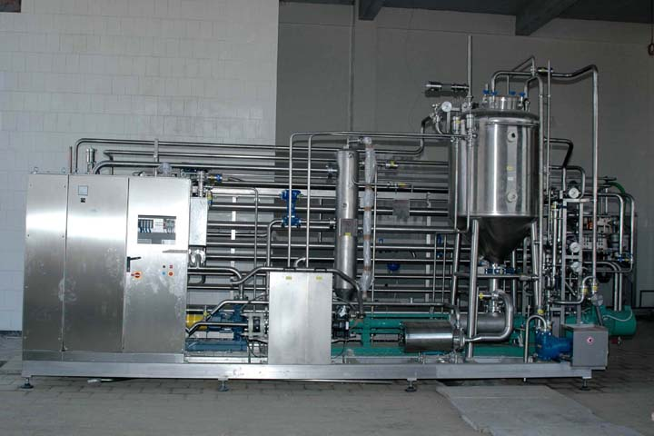
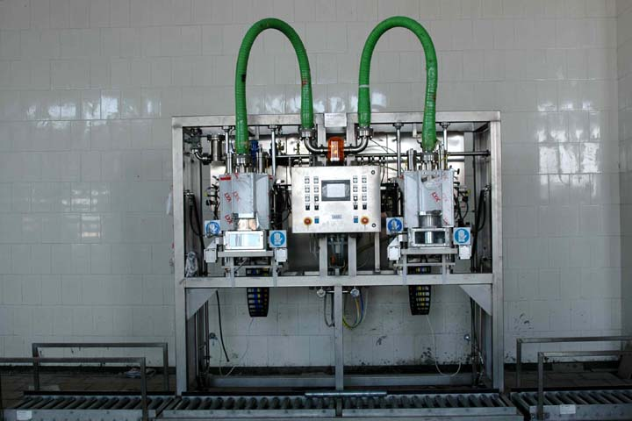
PUNJAB AGRO JUICES LIMITED

Slide 8
PROCESSING CAPACITY
PAJL IS PROCESSING A WIDE VARIETY OF FRUITS & VEGETABLES:-
PARTICULARS | PERIOD | NO. OF DAYS | FINISHED PRODUCT CAPACITY (IN MT)
KINNOWS | JAN FEB MAR | 60 | 4000
TOMATO / GOURDS | APR MAY JUN | 50 | 3500
CHILLI | JUN JULY AUG SEPT | 75 | 1500
MELONS | JUN JULY | 50 | 3000
GUAVA | JULY AUG /NOV DEC | 50 | 2500
MANGO | JULY AUG | 50 | 2500
PEAR / PEACH / PLUMS | AUG SEPT OCT | 50 | 3000
AMLA | NOV DEC JAN | 60 | 3000
APPLE | 0CT NOV | 45 | 2500
CARROTS | NOV DEC JAN | 50 | 1500

Slide 9
PUNJAB AGRO JUICES LIMITED
PRODUCTS
FRUIT / VEGETABLE | PRODUCTS
TOMATO | KETCHUP, SAUCE, PUREE, SOUP, PASTE
MANGO, KINNOW | JUICE, PULP, CONCENTRATE, JAM, MARMALADE, CANDY, JELLY, BURFI
APPLE | JUICE, CONCENTRATE, VINEGAR, WINE, MARMALADE, JELLY, BURFI
AMLA , ALOEVERA, JAMUN / BLACK CARROT | JUICE / HEALTH DRINK, CONCENTRATE
CHILLI | PASTE, INGREDIENT FOR OTHER PRODUCTS
UPCOMING PRODUCTS
MANGO PULP | TOMATO PUREE | KINNOW MARMALADE | KINNOW CARROT JUICE | BLACK CARROT VINEGAR | HONEY CHILLI SAUCE

Slide 10
PUNJAB AGRO JUICES LIMITED
SPECIALITIES
FRUIT / VEGETABLE | SPECIALITIES
KINNNOW (CITRUS) | FIRST OF THE KIND PLANTS IN THE COUNTRY TO DE-BITTER KINNOW/CITRUS
MANGO (DUSHERI) | PROCESSING & MANUFACTURING MANGO BEVERAGE FROM DUSHERI VARIETY (SWEET TASTE WITH RICH TEXTURE).
AMLA , ALOEVERA, JAMUN / BLACK CARROT | PROCESSING NON-CONVENTIONAL FRUITS & VEGETABLES TO CATER TO THE RAPIDLY GROWING HEALTH CONSCIOUS MARKET
CHILLI (RED & GREEN) | PROCESSING & EXPORTING AS PER CUSTOMER SPECIFICATIONS FOR MULTIPLE USES AS AN INGREDIENT

Slide 11
SAFE & SECURED OPERATIONS
PUNJAB AGRO JUICES LIMITED
● FSSC 22000 Certified and NPOP (India) & NOP (USA).
● Shock Treatment/Pasteurization/Sterilization to deactivate bacterial and enzymatic reactions.
● Anti-bacterial & mechanized processing to ensure hygienic operations.
● Aseptic packaging in 200 – 220 kg aseptic bags with shelf life in excess of 18 months.
● Testing & Lab unit – to test the samples after regular interval of processing.
● Well Equipped in-house quality assurance & micro-biological laboratory.
● In house product development.

Slide 12
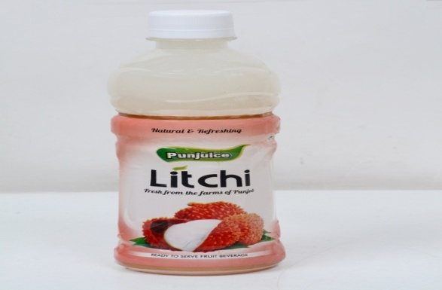
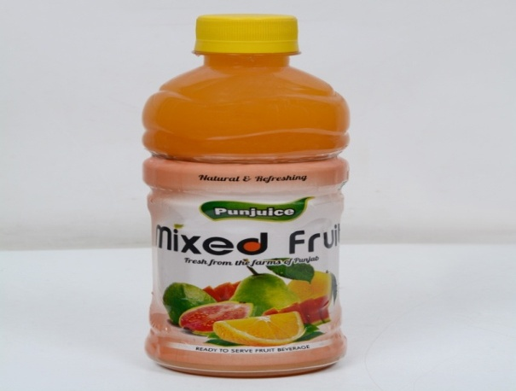
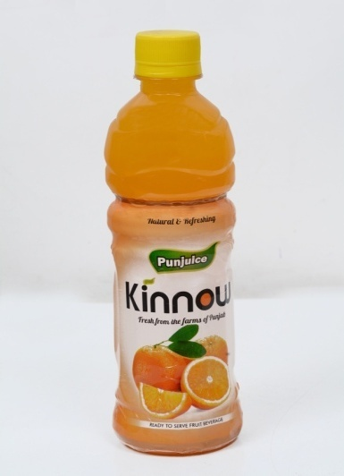
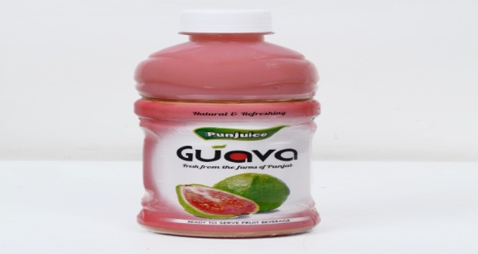
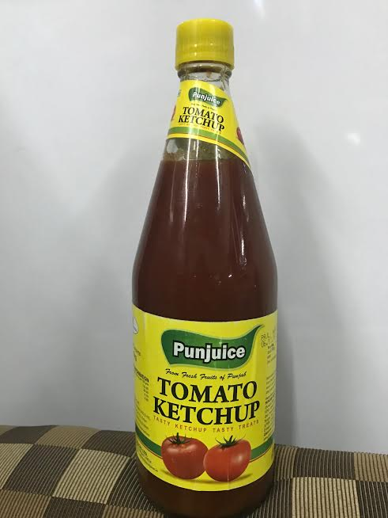
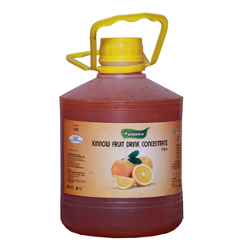
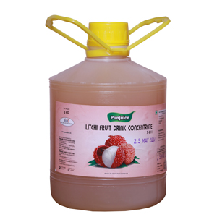
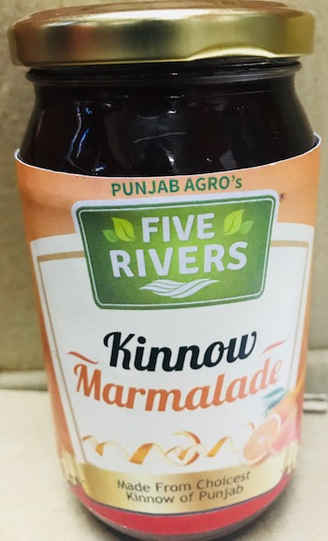
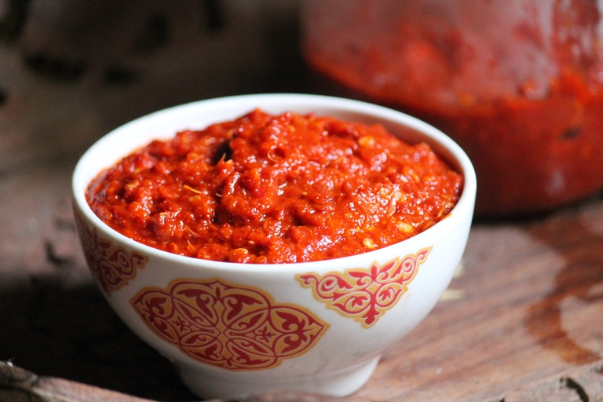
PAJL PRODUCTS

Slide 13
OUR CLIENTAGE

Slide 14
PUNJAB AGRI EXPORT CORPORATION LTD. (PAGREXCO)
● Punjab Agri Export Corporation (PAGREXCO) is a Government of Punjab (India) enterprise which was formed in 1997 to promote fresh agricultural produce mainly fruits, vegetables and processed products.
● We create infrastructure & mechanisms to facilitate distant domestic and export marketing of fruits & vegetables.
● We also introduce and develop new agri-technologies to improve the quality of horticulture produce.
● We invest in R&D for varietal trials on the new/existing agricultural produce having potential for exports.

Slide 15
INFRASTRUCTURE OFFERED BY PAGREXCO
PACK HOUSES FOR FRUITS &VEGETABLES:
● Six Pack Houses for fruits & vegetables all across the state:-
Ludhiana, Patiala, Hoshiarpur, Gurdaspur & Fatehgarh Sahib.
● Capacity of the pack house is 1.5 MT per hour.
● Facilities at pack houses:-
packing,
cooling,
pre-cooling (4 MT each)
cold storage (20 MT each),
sorting, store-room, etc.
● 2 pack houses have been accredited with APEDA Recognition Certificate
which is highly beneficial for carrying out exports.
● Recently, 400 MT fresh green chilli has been exported to UK from PAGREXCO pack house.

Slide 16
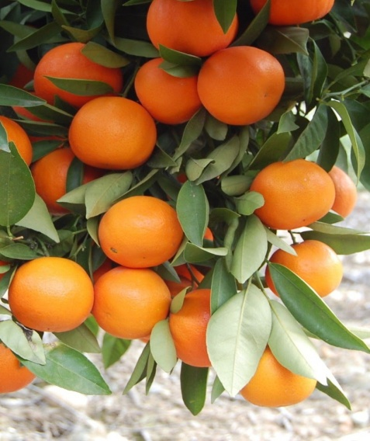
FIVE KINNOW GRADING AND WAXING CENTRES:-
● Kangmai , District Hoshiarpur
● Chhauni Kalan, District Hoshiarpur
● Badal, District Muktsar
● Balluana, District Fazilka
● Tahliwala Jattan, District Fazilka
● The grading lines are equipped with Imported Volumetric Electronic grader having best accuracy with no human intervention.
● Cold storage & Pre-cooling facility at Badal(250 MT) & Kangmai kinnow grading centre have been set up.

Slide 17
E-MARKETING OF PUNJA KINNOW THROUGH NEML (NCDEX E MARKETS LTD)
● NCDEX e Markets Limited (NeML) is India’s Biggest Agriculture trading platform, backed by largest Agri commodity exchange of India National Commodity & Derivative Exchange.
● NeML has created a platform specially to handle the intricacies of fresh fruits and vegetable trade which has been named FFresh.
● Punjab Agri Export Corporation Limited (PAGREXCO) has joined hands with NeML’s FFresh for marketing of Punjab’s Kinnow in distant domestic markets of India by facilitating & educating Punjab farmers.

Slide 18
WHAT WE OFFER
● Certified Organic Products of Wheat, Rice, Maize, etc.
● Best Quality kinnow fruit duly waxed & packed as per International Standards.
● Other fresh vegetables like Potato, Carrot, Chillies, Tomato, Cauliflower, all Indian & Leafy vegetables, duly graded & packed at our Pack houses, as per demand of the buyer.
● APEDA recognized pack houses for packing of fresh fruits & vegetables by facilitating the exporters/farmers.

Slide 19
ORGANIC PRODUCTS
Sr. No. | Product we can Offer |  | Estimated* quantity (in MT)
Wheat and Wheat Products
1 |  | Wheat and Wheat Products | 2000
2 |  | Wheat Flour | 1900
3 |  | Wheat Dalia | 1200
Basmati Paddy and its Products
4 |  | Basmati Paddy | 1200
5 |  | Basmati Rice | 480
6 |  | Basmati Brown Rice | 504
Maize and Maize Products
7 |  | Maize | 100
8 |  | Maize Flour | 95
9 |  | Maize Dalia | 60
Others
10 |  | Turmeric Powder | 1000
11 |  | Mustard | 10
12 |  | Mustard Oil | 4000 Litre
13 |  | Moong | 10
14 |  | Chickpea | 10
15 |  | Urad/Mah | 5
Sr. No. | Product we can Offer |  | Estimated* quantity (in MT)
Wheat and Wheat Products
1 |  | Wheat and Wheat Products | 2000
2 |  | Wheat Flour | 1900
3 |  | Wheat Dalia | 1200
Basmati Paddy and its Products
4 |  | Basmati Paddy | 1200
5 |  | Basmati Rice | 480
6 |  | Basmati Brown Rice | 504
Maize and Maize Products
7 |  | Maize | 100
8 |  | Maize Flour | 95
9 |  | Maize Dalia | 60
Others
10 |  | Turmeric Powder | 1000
11 |  | Mustard | 10
12 |  | Mustard Oil | 4000 Litre
13 |  | Moong | 10
14 |  | Chickpea | 10
15 |  | Urad/Mah | 5

Slide 20
INSTITUTIONAL SUPPORT TO FARMERS
Moblization: Awareness Camps
Registration: In Cluster Forms
Training, Guidance and Technical support :
Organic Standard, Organic farm Management, on farm inputs.
Monitoring:- Regular visits, Internal & External Audits.
Certification:- Internal Quality Control System, Documentation,
Traceability, External audits:- Generation of Organic Certificate

Slide 21
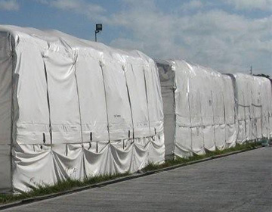
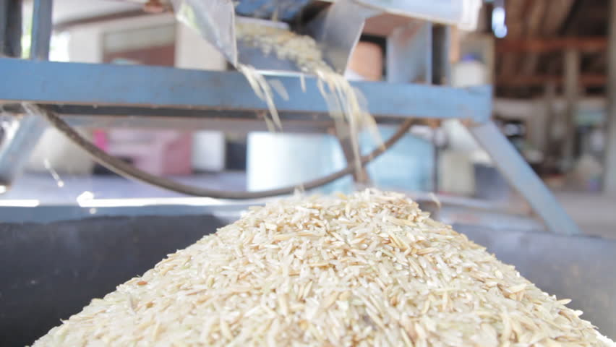
STORAGE/ PROCESSING
Procurement from Certified Organic farms at remunerative prices to farmers.
Residue testing.
Storage in specialized structure, the cocoons.
Processing at Certified Organic mills explicitly for the purpose.
Certified Organic Products
Brand “FIVE RIVERS”
The Samples passed at renowned lab of Germany

Slide 22
The Whole Process- production system, storage, processing, packing, labelling, trading is verified through Organic Certification.
Organic Certification
Procurement/Storage
Processing at Certified Organic Plant
Farmer
Consumer
Marketing Platforms

Slide 23
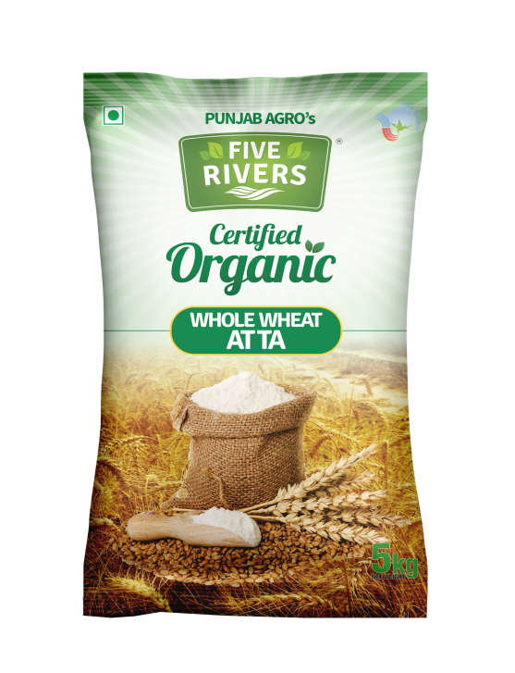
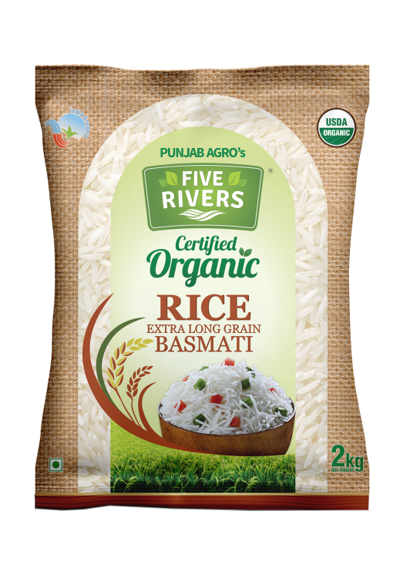
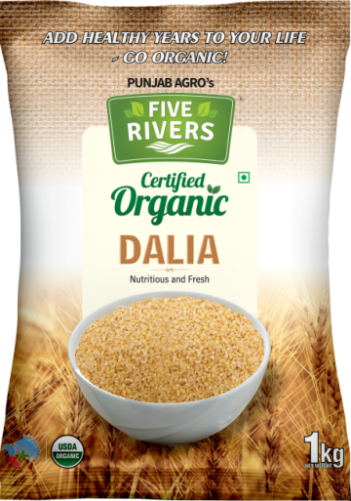
OUR CERTIFIED ORGANIC PRODUCTS

