Slide 2
A Special Purpose & Vision
Punjab Agro Juices Limited was established in 2006 by Government of Punjab (India) to support the cause of small and marginal farmers & state’s production of fruits and vegetables which have short harvesting seasons by-
Enabling them to earn higher incomes per acre of land
Bringing advanced technology & hi-tech infrastructure that could facilitate quick processing of farm harvests and reaching the far markets-off markets/ customers through the desired range of processed fruits & vegetable products
Providing employment to the local people
Reducing the percentage of wastage of unsold harvests of farmers

Slide 3
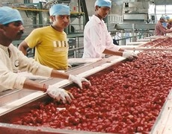
Infrastructure
Two multi fruit/vegetable processing units at Hoshiarpur and Abohar, each spread over an area of 34 acres of land.
Plants have capacties to handle 20 Mts per hour citrus fruits & 10 Mts per hour of other fruits & vegetables with cold storage as well as deep freezer capacity of 1000MT each at both the plants.

Slide 4
Innovative/ Continuous Improvement Approach
Cutting edge innovative technology capable of handling and processing a variety of fruits & vegetables
Use of latest technology/ imported machinery from Rossie & Catelli Italy
Plant & machinery has been procured from CFT SPA, Italy, a leading international food engineering company
Continuous research to develop new flavors that combine good taste and health benefits
Turn-key projects and complete lines for food processing companies.

Slide 5
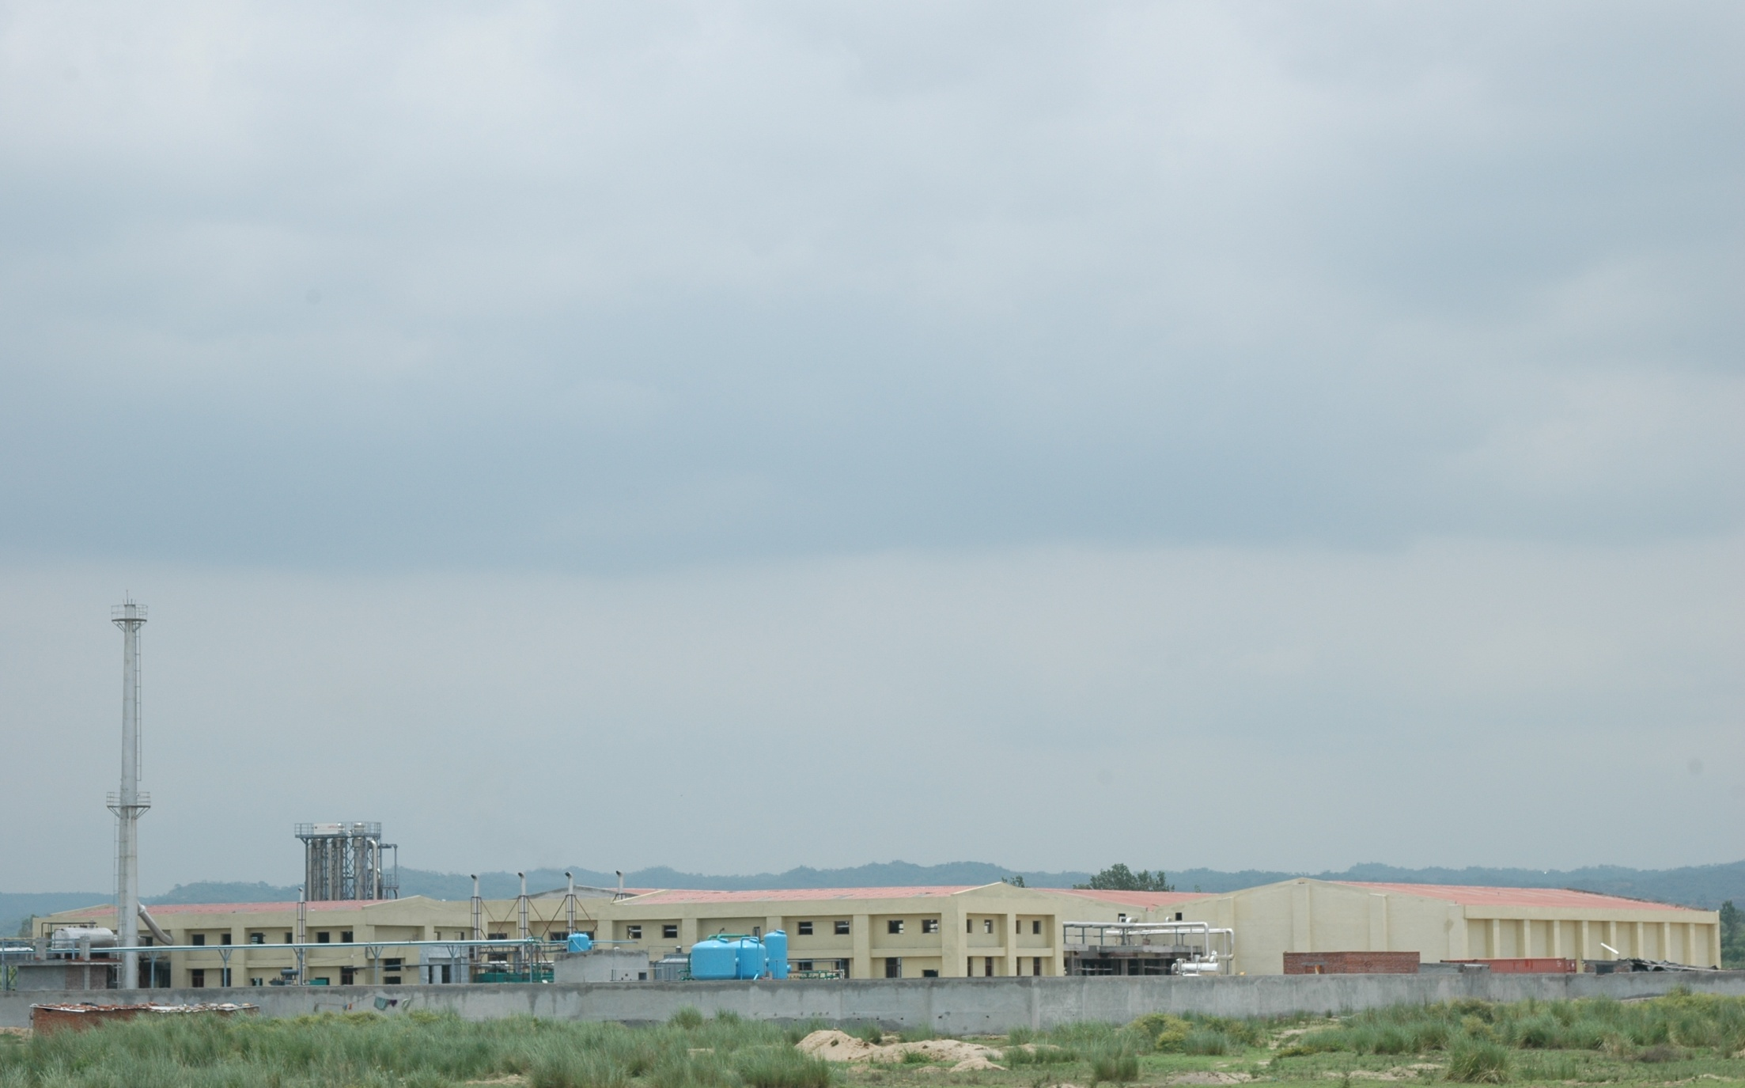
Plant Panoramic View

Slide 6
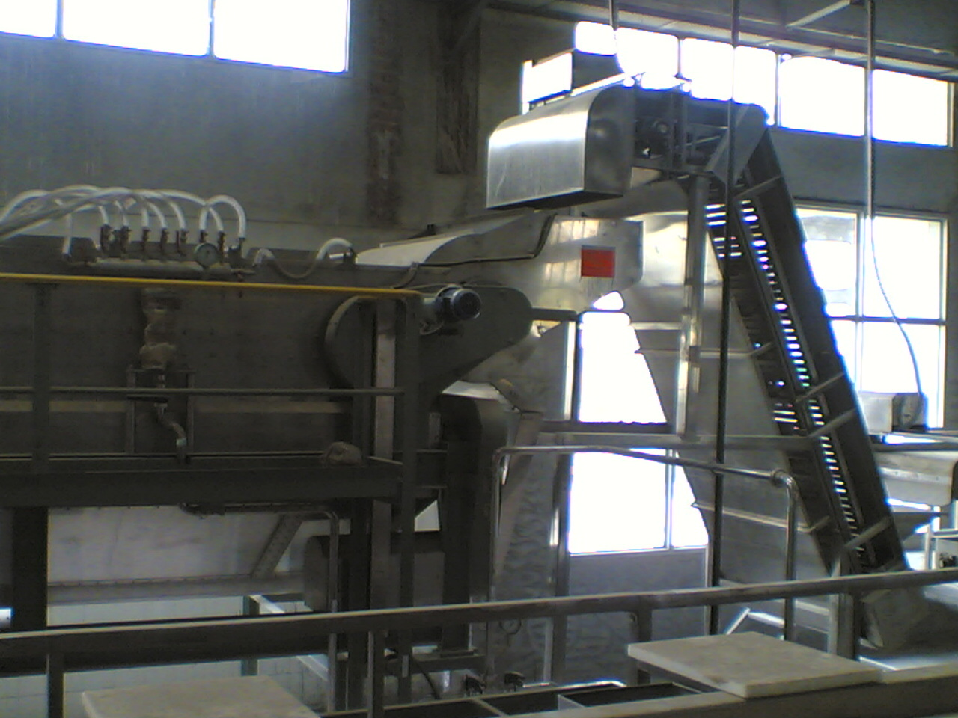
Citrus Rasper
Cont’d

Slide 7
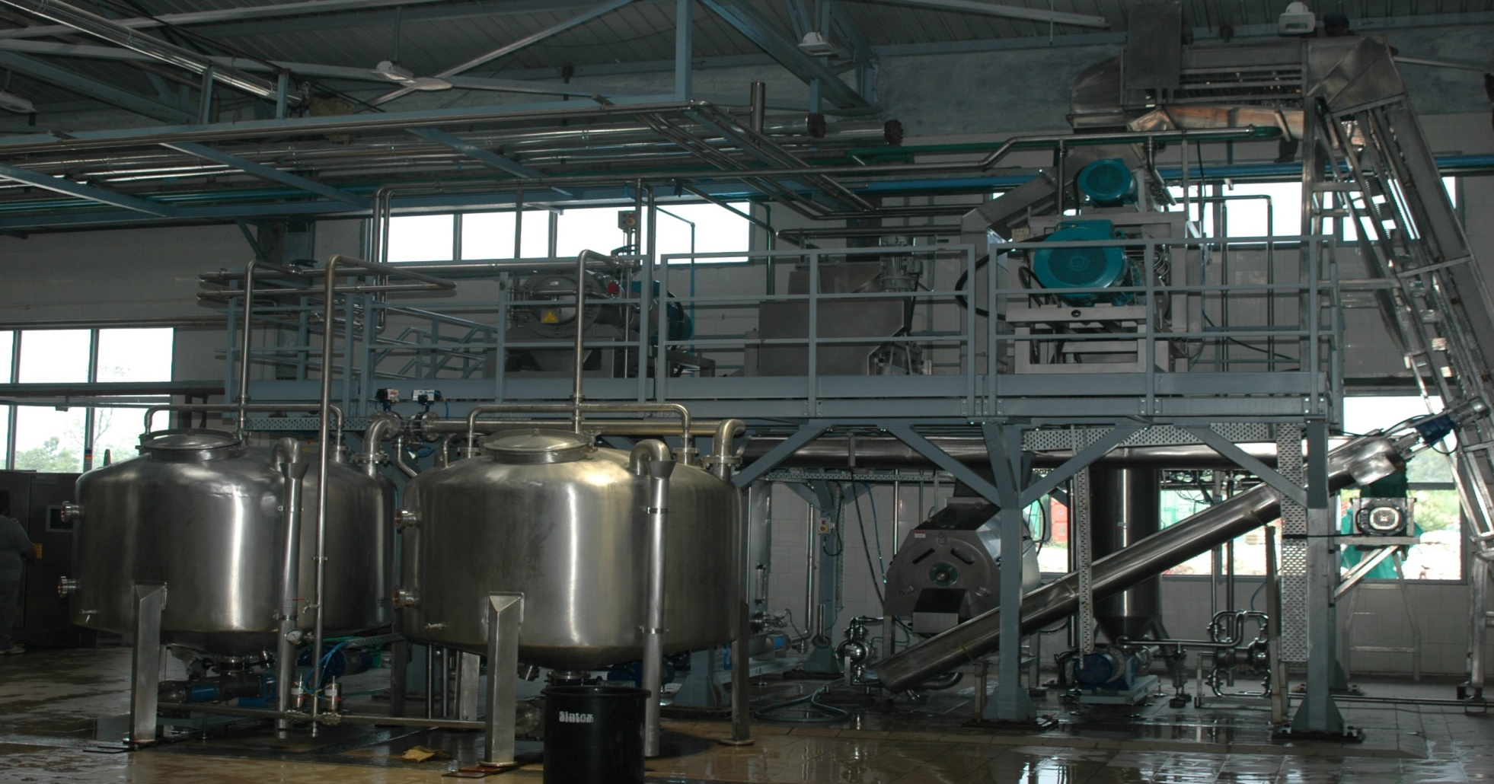
Cold Extractor, Refiner & De stoner
Cont’d

Slide 8
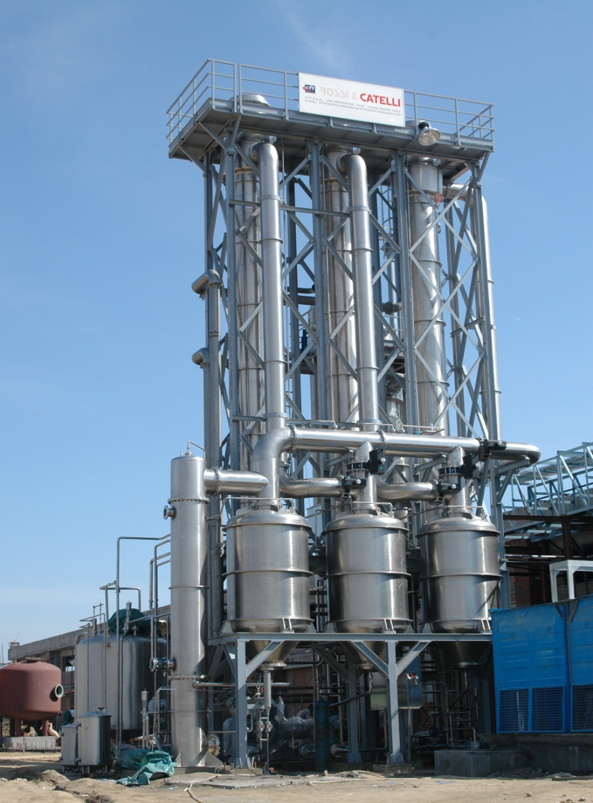
Evaporator
Cont’d

Slide 9
ASEPTIC PACKING EQUIPMENT
Cont’d

Slide 10
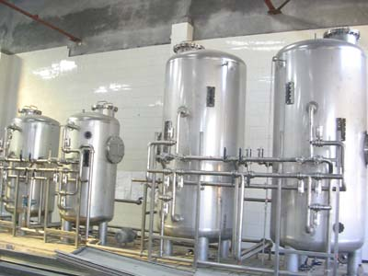
DIBITTERING EQUIPMENTS

Slide 11
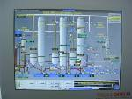
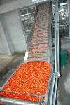
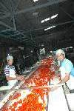
TOMATO PASTE PROCESSING
Cont’d

Slide 12
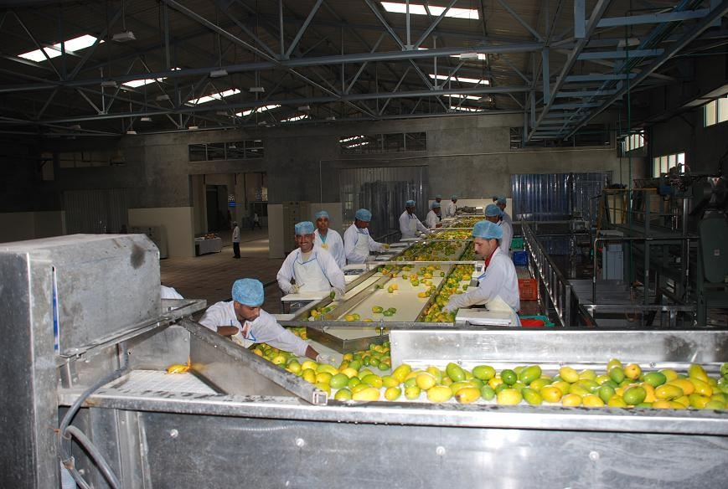
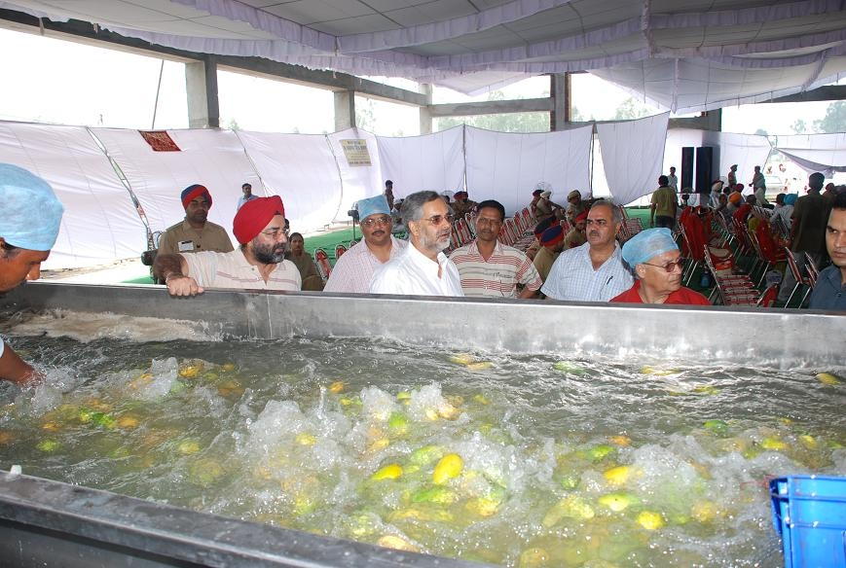
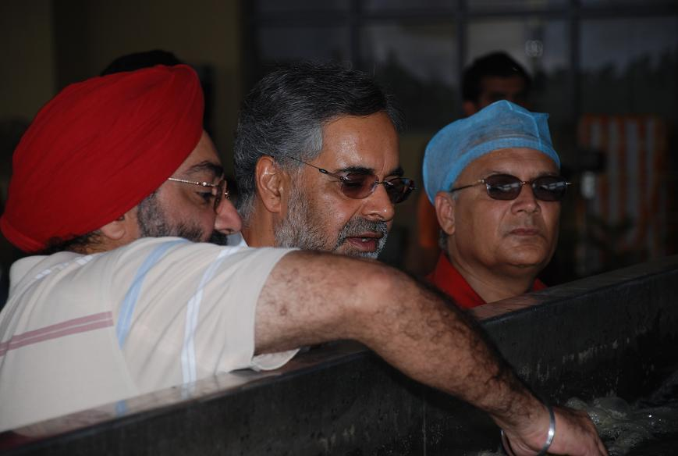
MANGO PROCESSING

Slide 13
Safe & Secured Operations
FSSC 22000 Certified.
Shock Treatment/ Pasteurization/ Sterilization to deactivate bacterial and enzymatic reactions.
Anti-bacterial & mechanized processing to ensure hygienic operations.
Aseptic packaging –
In 200 ltrs bulk aseptic bags
Kept in MS drums with their shelf life being 12 months or more.
In-house Cold Storage facility for stocking fruits
Normal Cold Storage - Capacity of 1000MT to Freeze.
Frozen Cold Storage - Capacity to freeze the material up to -20° C.
Testing & Lab unit – to test the samples after regular interval of processing.

Slide 14
BLENDING & PACKING PLANT FACILITIES-FEATURES
Blending ,packing facility to provide unique product configuration
Opportunity to provide quality products to customers at competitive price
Blended products to be offered for sales in aseptically packed bulk and consumer packs in PET bottles

Slide 15
Our Clientage
Some of our key domestic and multinational customers include–

Slide 16
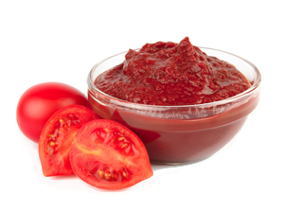
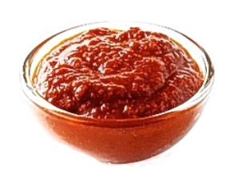
Our Products

Slide 17
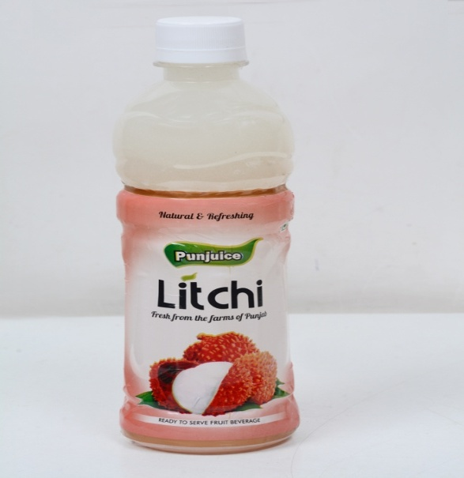
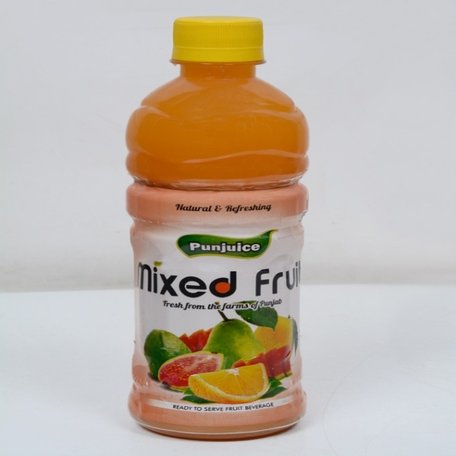
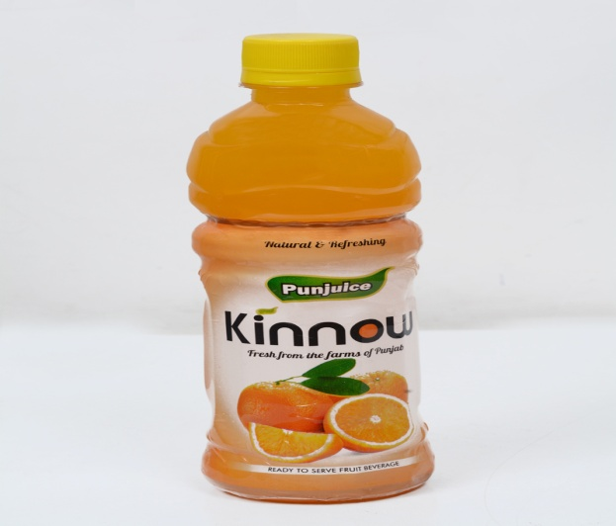
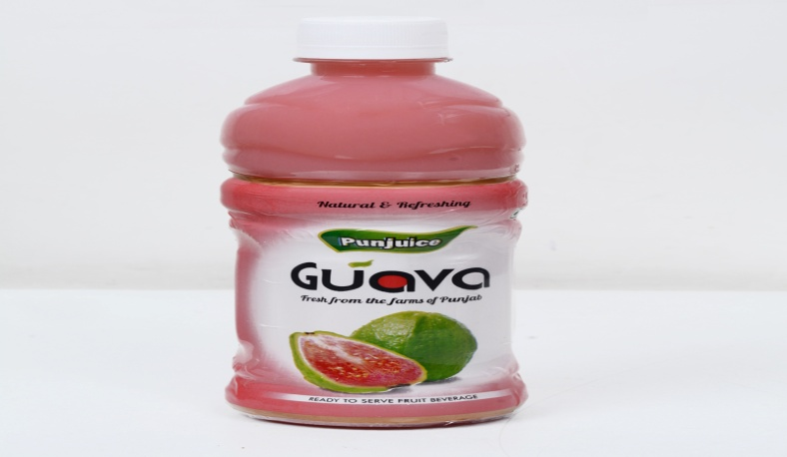
Our products in market

Slide 18
Thanks
Contact us
Punjab Agro Juices Limited Plot No. 2-A, Sector 28A, Chandigarh-160002 (INDIA)
Phone :
0091-172-2658082, 4639271, 4640060/70 E-mail :
ceo@punjuice.in,
headmp@punjuice.in, pajlchd@punjuice.in, www.punjuice.in

